Slide 1
Machine Learning

Slide 2
What is Machine Learning?

Slide 3
Traditional Software Development

Slide 4
Traditional Software Development
Convert inches to cm

Slide 5
Traditional Software Development
Convert inches to cm
Input:
Output:

Slide 6
Traditional Software Development
Convert inches to cm
Input: inches
Output:

Slide 7
Traditional Software Development
Input: inches
Relationship: cm =
Output:

Slide 8
Traditional Software Development
Input: inches
Relationship: cm = inches * 2.54
Output:

Slide 9
Traditional Software Development
Input: inches
Relationship: cm = inches * 2.54
Output: cm

Slide 10
Traditional Software Development

Slide 11
Traditional Software Development
Convert a number to its absolute value

Slide 12
Traditional Software Development
Convert a number to its absolute value
Input:
Output:

Slide 13
Traditional Software Development
Convert a number to its absolute value
Input: number
Output:

Slide 14
Traditional Software Development
Convert a number to its absolute value
Input: number
Rules:
Output:

Slide 15
Traditional Software Development
Input: number
Rules:
if number >= 0: abs. value = number
Output:

Slide 16
Traditional Software Development
Input: number
Rules:
if number >= 0: abs. value = number
Output:

Slide 17
Traditional Software Development
Input: number
Rules:
if number >= 0: abs. value = number
else: abs. value = number * -1
Output:

Slide 18
Traditional Software Development
Input: number
Rules:
if number >= 0: abs. value = number
else: abs. value = number * -1
Output: abs. value

Slide 19
Traditional Software Development

Slide 20
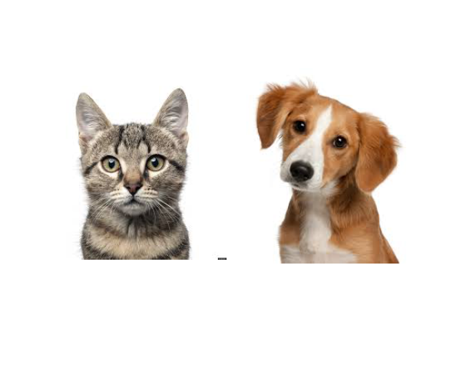
Traditional Software Development

Slide 21
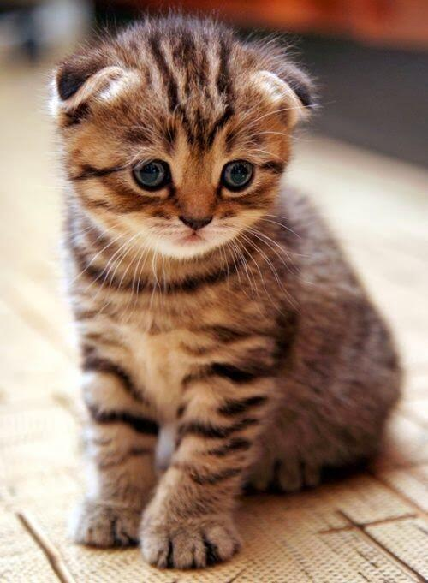

Slide 22
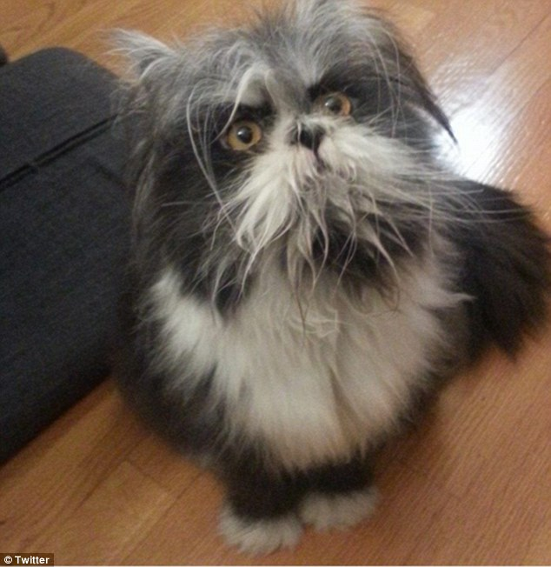

Slide 23
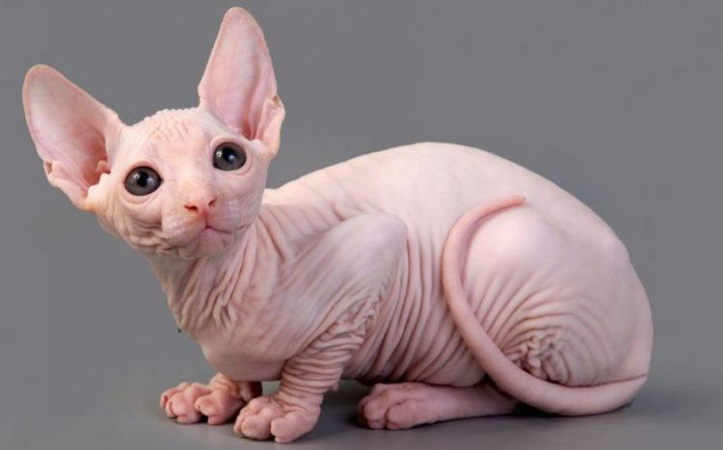

Slide 24
Traditional Software Development
Input:
Rules:
Output:

Slide 25
Traditional Software Development
Input:
Rules: rule 1
rule 2
rule 3 …
Output:

Slide 26
Traditional Software Development
Input:
Rules: rule 1
rule 2
rule 3 …
Output: “cat”

Slide 27
Machine Learning

Slide 28
Machine Learning
Input | 0 | 8 | 15 | 22 | 38
Output | 32 | 46.4 | 59 | 71.6 | ?

Slide 29
Machine Learning
Input | 0 | 8 | 15 | 22 | 38
Output | 32 | 46.4 | 59 | 71.6 | 100.4

Slide 30
F = C * 1.8 + 32
Celsius | 0 | 8 | 15 | 22 | 38
Fahrenheit | 32 | 46.4 | 59 | 71.6 | 100.4

Slide 31
Machine Learning
Input: [0, 8, 15 22]

Slide 32
Machine Learning
Input: [0, 8, 15 22]
Output: [32, 46.4, 59, 71.6]

Slide 33
Machine Learning
Input: [0, 8, 15 22]
Relationship: ?
Output: [32, 46.4, 59, 71.6]

Slide 34

Common ML Algorithms
Linear Regression
Logistic Regression
Naïve Bayes
Support Vector Machine
Decision Tree
K-Nearest Neighbor
=

Slide 35
Machine Learning
Input: [0, 8, 15 22]
Relationship:
Output: [32, 46.4, 59, 71.6]

Slide 36
Machine Learning
Input: [0, 8, 15 22]
Relationship: input *1.8 + 32
Output: [32, 46.4, 59, 71.6]

Slide 37
Machine Learning
Input: [0, 8, 15 22]
Model
Relationship: input *1.8 + 32
Output: [32, 46.4, 59, 71.6]

Slide 38
Machine Learning
ML Model
input *1.8 + 32

Slide 39
Machine Learning
ML Model
New input: 38
input *1.8 + 32

Slide 40
Machine Learning
ML Model
New input: 38
input *1.8 + 32
output: 100.4

Slide 41


DATA
ALGORITHM
MODEL

Slide 42

DATA
ALGORITHM
MODEL
NEW DATA
MODEL
PREDICTIONS

Slide 43
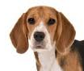
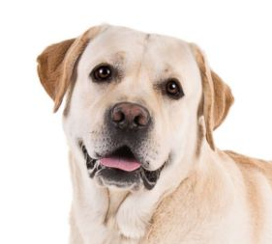
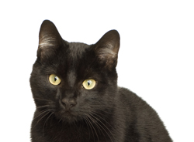

Machine Learning
Input:[ , , , ]
Relationship:
Output: [“cat”, “dog”, “dog”, “cat]

Slide 44
Machine Learning
Input:[ , , , ]
Relationship:
Output: [“cat”, “dog”, “dog”, “cat]

Slide 45
Pareidolia

Slide 47
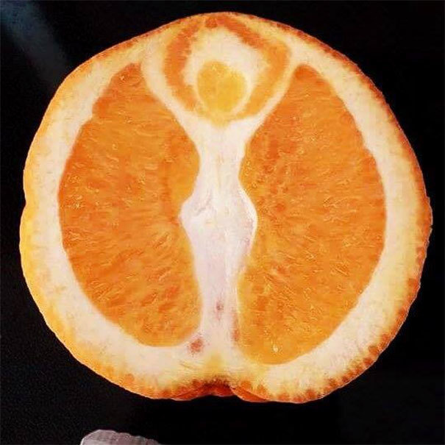

Slide 48
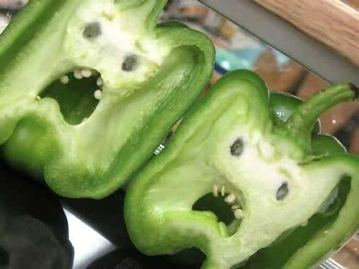

Slide 49
Machine Learning
Instead of programming a computer, you give a computer examples and it learns what you want.

Slide 50
Why ML Now?

Slide 51
Why ML Now?
Increasing availability of data

Slide 52
Why ML Now?
Increasing availability of data
Sophistication of ML algorithms

Slide 53
Why ML Now?
Increasing availability of data
Sophistication of ML algorithms
Increasing power and availability of computing hardware and software

Slide 54
Types of Machine Learning

Slide 55
Supervised
Unsupervised

Slide 56

Music
Song | Artist | Genre | Liked
Breathing Light | Frameworks | Alternative Rock | Yes
Superior | Silver Maple | Pop | No
Icicle | AK | Pop | No
Jazzin | Flap Jack | R&B | Yes
The Way You Do | Schlomo | R&B | Yes
Mirror Maru | Cashmere | Rock | Yes
Never Too Far | Sorrow | Pop | No

Slide 57
Music
Features
(X)
Song | Artist | Genre | Liked
Breathing Light | Frameworks | Alternative Rock | Yes
Superior | Silver Maple | Pop | No
Icicle | AK | Pop | No
Jazzin | Flap Jack | R&B | Yes
The Way You Do | Schlomo | R&B | Yes
Mirror Maru | Cashmere | Rock | Yes
Never Too Far | Sorrow | Pop | No

Slide 58
Music
Song | Artist | Genre | Liked
Breathing Light | Frameworks | Alternative Rock | Yes
Superior | Silver Maple | Pop | No
Icicle | AK | Pop | No
Jazzin | Flap Jack | R&B | Yes
The Way You Do | Schlomo | R&B | Yes
Mirror Maru | Cashmere | Rock | Yes
Never Too Far | Sorrow | Pop | No
Target
(y)

Slide 59
Music
Song | Artist | Genre | Liked
Breathing Light | Frameworks | Alternative Rock | Yes
Superior | Silver Maple | Pop | No
Icicle | AK | Pop | No
Jazzin | Flap Jack | R&B | Yes
The Way You Do | Schlomo | R&B | Yes
Mirror Maru | Cashmere | Rock | Yes
Never Too Far | Sorrow | Pop | No
Labels

Slide 60
Supervised
Unsupervised
Features | Label
 | Yes
 | No
 | No
 | Yes
 | Yes
 | Yes
 | No
Features | Label

Slide 61
Clustering

Slide 62
Clustering

Slide 63
Clustering
Pop
genre
Rock

Slide 64
Clustering
‘90s
decade
‘00s

Slide 65
Supervised
Unsupervised
Regression
Clustering
Classification

Slide 66
Data

Slide 67
The best data has 3 qualities:
Clean
Coverage
Complete

Slide 68
The best data has 3 qualities:
Feature 1 | Feature 2 | Feature 3 | Feature 4
Male | 200 | 1 | Yes
Female | 316 | 3 | No
F | 190 | 1 | No
Male | 244 |  | Yes
Male | 128 | 2 | Yes
Male |  | 3 | Yes
Female | 302 | 2 | No

Slide 69
Clean
Feature 1 | Feature 2 | Feature 3 | Feature 4
Male | 200 | 1 | Yes
Female | 316 | 3 | No
F | 190 | 1 | No
Male | 244 | 13 | Yes
Male | 128 | 2 | Yes
Male |  | 3 | Yes
Female | 302 | 2 | No

Slide 70
Coverage
Feature 1 | Feature 2 | Feature 3 | Feature 4
Male | 200 | 1 | Yes
Female | 316 | 3 | No
F | 190 | 1 | No
Male | 244 |  | Yes
Male | 128 | 2 | Yes
Male |  | 3 | Yes
Female | 302 | 2 | No
depth

Slide 71
Complete
breadth
Feature 1 | Feature 2 | Feature 3 | Feature 4
Male | 200 | 1 | Yes
Female | 316 | 3 | No
F | 190 | 1 | No
Male | 244 |  | Yes
Male | 128 | 2 | Yes
Male |  | 3 | Yes
Female | 302 | 2 | No

Slide 72


Slide 73
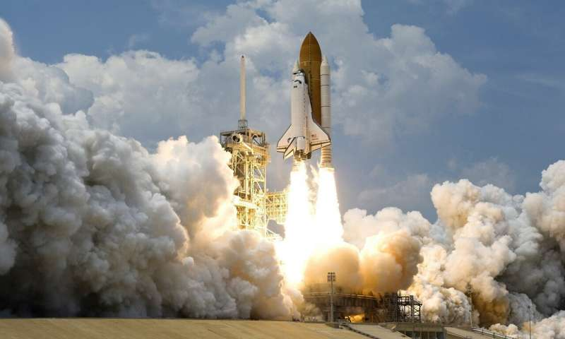
If ML is a rocket engine,
data is the fuel

Slide 74
Model Training

Slide 75
Model Training
DATA
MODEL

Slide 76
Model Training
Prediction
0
1
0
0
1
0
DATA
MODEL

Slide 77
Model Training
Prediction | Label
0 | 1
1 | 1
0 | 0
0 | 1
1 | 0
0 | 0
DATA
MODEL

Slide 78
Model Training
Prediction | Label
0 | 1
1 | 1
0 | 0
0 | 1
1 | 0
0 | 0
DATA
MODEL

Slide 79
Model Training
Prediction | Label
0 | 1
1 | 1
0 | 0
0 | 1
1 | 0
0 | 0
DATA
MODEL

Slide 80
Model Training
Prediction | Label
1 | 1
1 | 1
0 | 0
1 | 1
0 | 0
0 | 0
DATA
MODEL

Slide 81
Model Training
Prediction | Label
1 | 1
1 | 1
0 | 0
1 | 1
0 | 0
0 | 0
DATA
MODEL

Slide 82
Model Training
TRAINED MODEL

Slide 83
Model Training
MODEL
MODEL
MODEL
MODEL
MODEL

Slide 84
Evaluate the Model

Slide 85
Evaluate the Model
Training Data
Test Data

Slide 86
Train

Slide 87
Train
Test

Slide 88
Train
Test
Deploy

Slide 89
ML Process
Get Data
Prepare Data
Model Data
Refine Model
Deploy Model

Slide 90
ML Process
Get Data
Prepare Data
Model Data
Refine Model
Deploy Model
What data should you use?
Is it labeled?

Slide 91
ML Process
Get Data
Prepare Data
Model Data
Refine Model
Deploy Model
Is your data complete, clean, does it have coverage?

Slide 92
ML Process
Get Data
Prepare Data
Model Data
Refine Model
Deploy Model
Which algorithms should you use?

Slide 93
ML Process
Get Data
Prepare Data
Model Data
Refine Model
Deploy Model
What level of performance is sufficient?

Slide 94
ML Process
Get Data
Prepare Data
Model Data
Refine Model
Deploy Model
Make predictions.

Slide 95
Predictive Insights

Slide 96
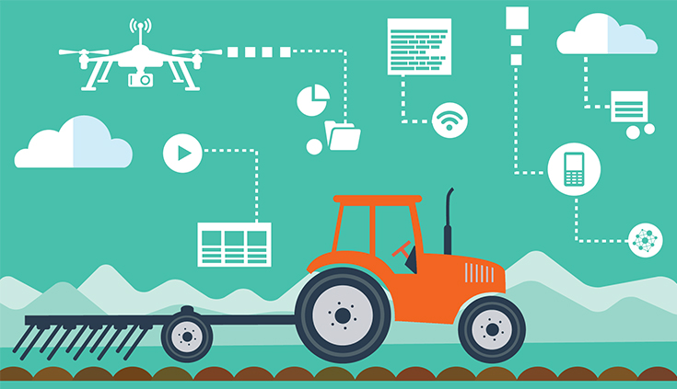
AgTech

Slide 97
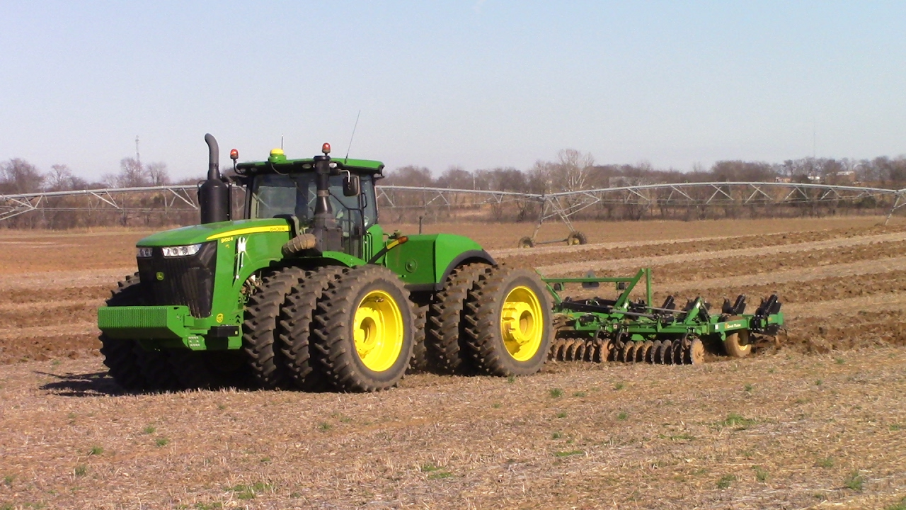
AgTech
Water Management
Plant Soil Analytics
Weather Forecasting
Predictive Machine Failure
Pest/Disease Identification

Slide 98
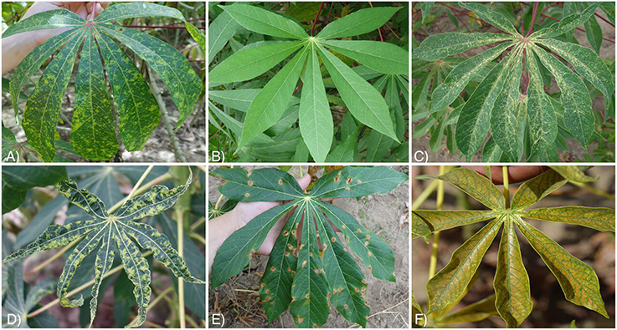

Slide 99
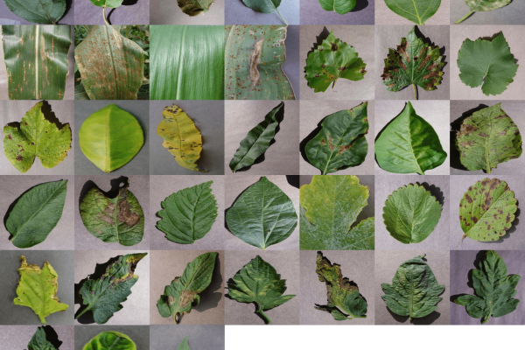

Slide 100
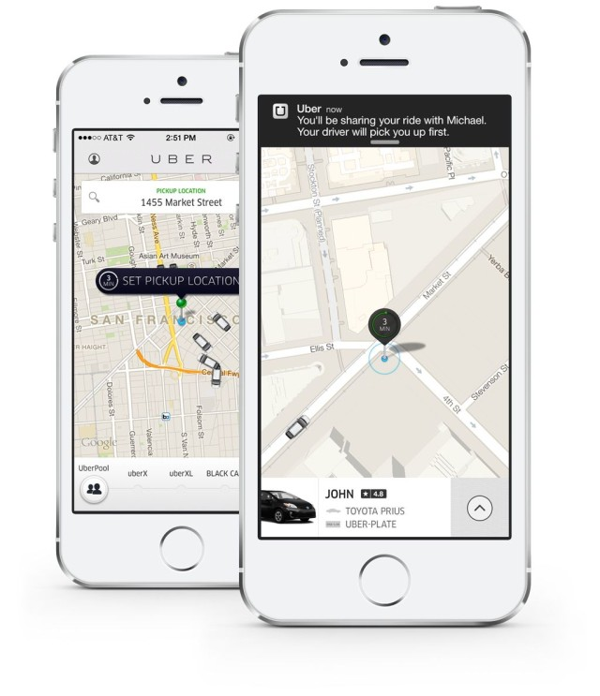


Slide 101
Machine Learning

Slide 102
Machine Learning
Supply-Demand

Slide 103
Machine Learning
Supply-Demand
Route Optimization

Slide 104
Machine Learning
Supply-Demand
Route Optimization
Rush Hour Pool

Slide 105
AI vs. Machine Learning

Slide 106
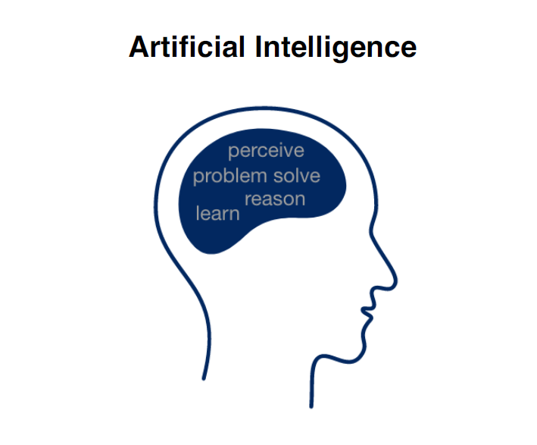

Slide 107
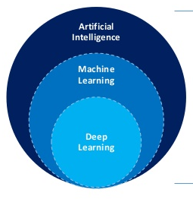
Machine Learning is a type of AI

Slide 108
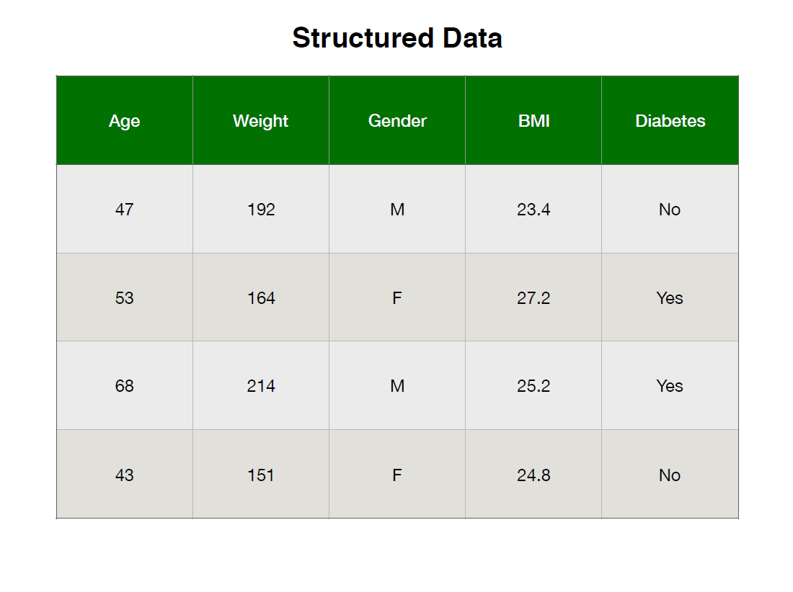

Slide 109
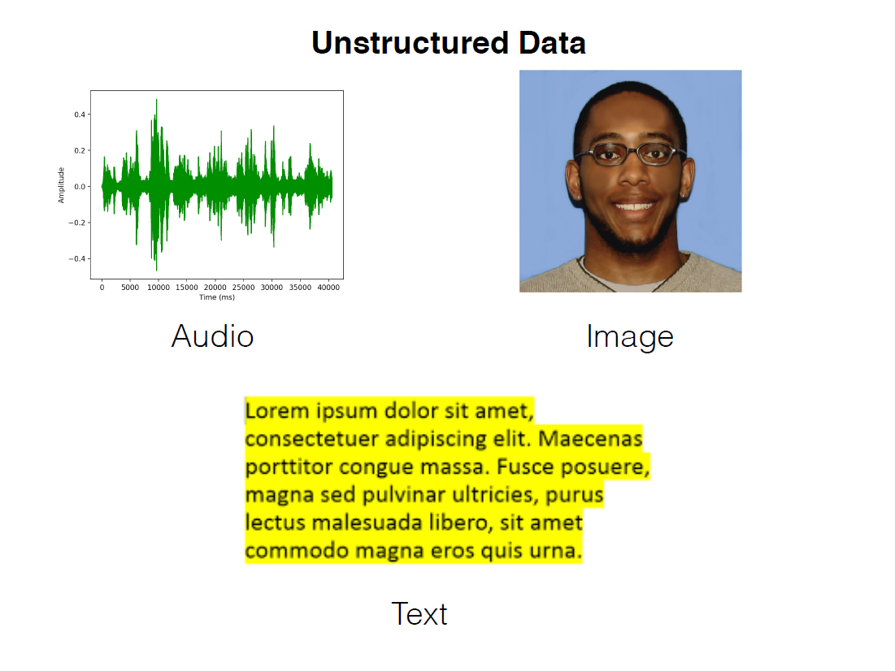

Slide 110
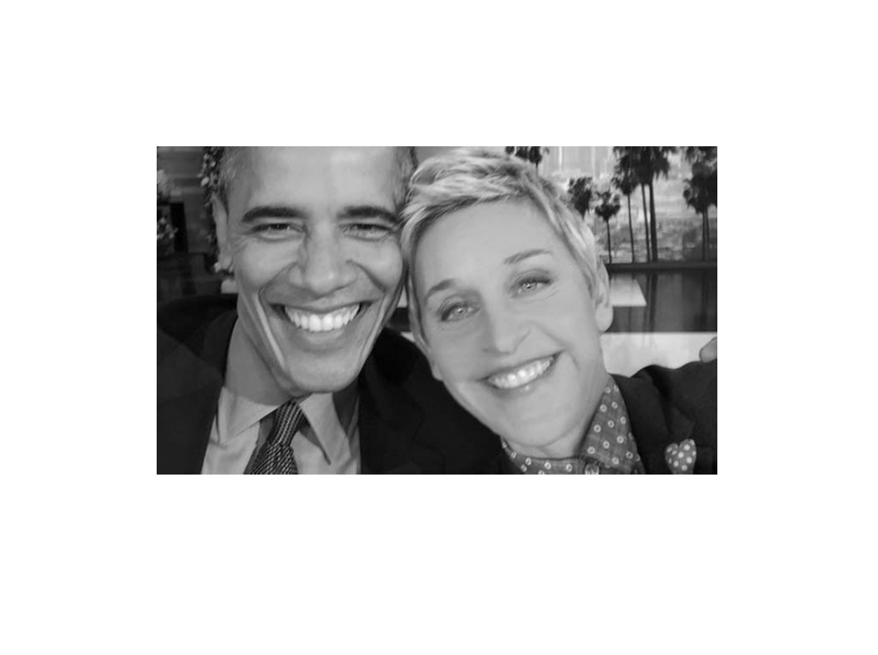

Slide 111
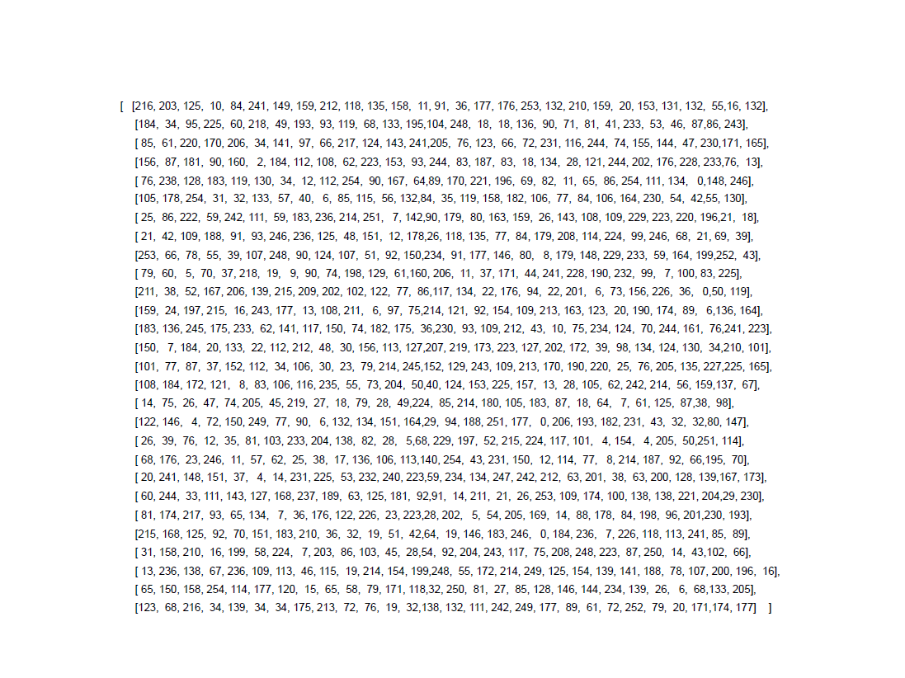

Slide 112
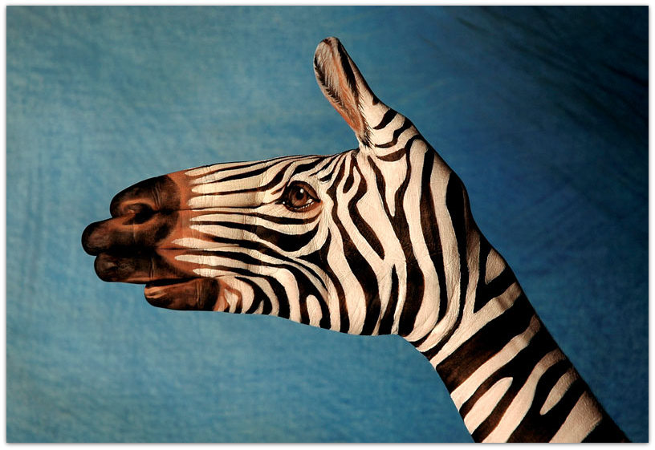

Slide 113




